Slide 1
Project Meeting
2018/9/7

Slide 2

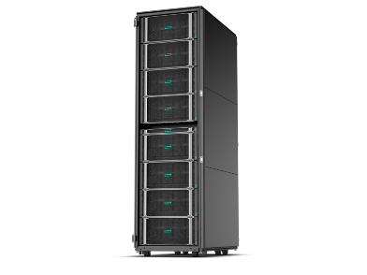





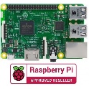



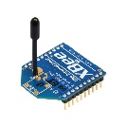

Architecture
Cloud server
Cloud Layer
node
node
Fog Layer
node
node
node
Sensor Layer
device
device
device
device
device
device

Slide 3
Application
--- Smart Grid ---

Slide 4
Smart Grid
Data Security
Experiment architecture

Slide 5
Data Security
Deep Learning ➔ Data Anomaly
Attack Detection
Distributed deep learning architecture
BlockChain ➔ Data Integrity
Defense data falsify
Lighting transaction mechanism

Slide 6
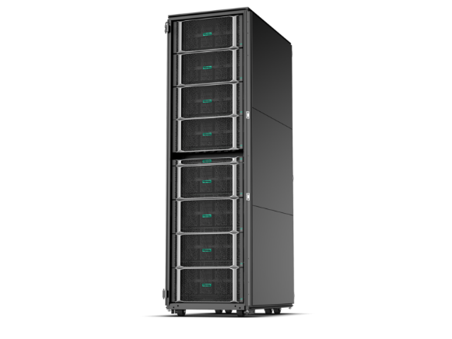


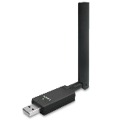
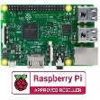


Experiment architecture
Cloud
Layer
Node
Layer
Sensor
Layer

Slide 7


LoRa model & gateway
Two ways:
Use default gateway
Device: Raspberry Pi, LoRa module (Antenna), LoRa gateway(Advantech)
Use private gateway
Device: Raspberry Pi, LoRa module (Antenna), private gateway(LoRa dongle+Raspberry Pi)
Sensor

Slide 8
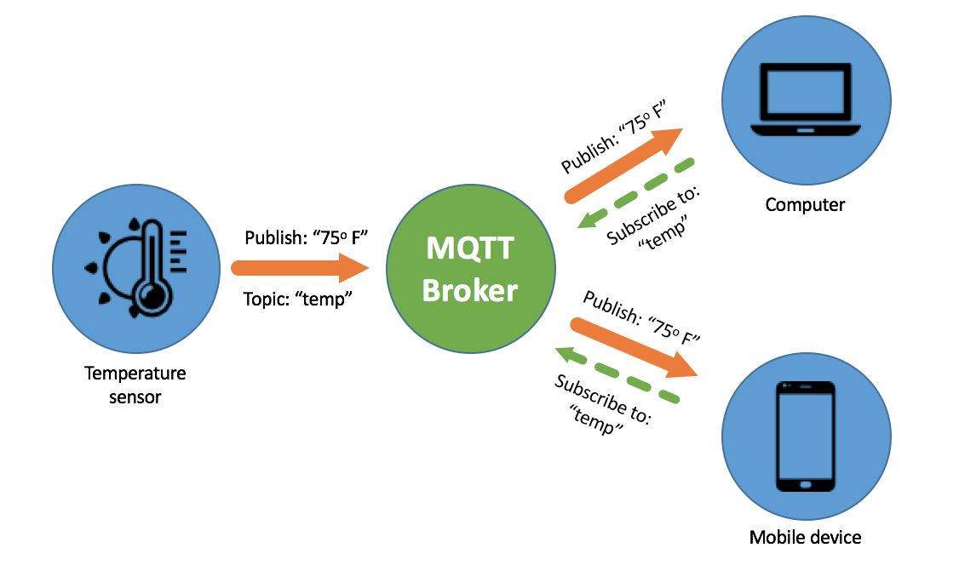
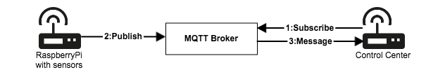
Communication
Lightweight IoT protocol: MQTT
How it worsk:
Support Raspberry Pi
Notes:
message queuing telemetry transport 消息隊列遙測傳輸
他們當時是為了在狹窄的網路頻寬和微小電力損耗的需求前提之下，提供石油管線感測器和人造衛星之間一個輕量、可靠的二進制通訊協定
讓你能盡可能即時又省資源的情況下，確保訊息被 Push 至移動裝置。他的設計是發佈/訂閱模式(Publish subscribe pattern)，讓你能對特定裝置(broker)訂閱主題，並能盡可能的以節省資源的方式確保有發送到訂閱的 client 上。
代理人是個伺服器軟體，向伺服器發送主題的一方是發布者（publisher），從伺服器獲取主題的一方則是訂閱者（subscriber）。
名稱長度不可超過216位元組

Slide 9
MQTT vs HTTP
 | MQTT | HTTP
Full form | Message Queue Telemetry Transport | Hyper Text Transfer Protocol
Architecture | It has publish/subscribe architecture | It has request/response means Client/Server architecture
Upper layer protocol | TCP | UDP
message size | Small | Large
Message format | Binary with 2 byte hearder | ASCII format
Data distribution | 1 to 1/N | 1 to 1
Complexity | simple | complex
Notes:
它有發布/訂閱架構 它有請求/響應意味著客戶端/服務器架構
帶2字節聽筒的二進製文件 ASCII格式
代理人是個伺服器軟體，向伺服器發送主題的一方是發布者（publisher），從伺服器獲取主題的一方則是訂閱者（subscriber）。
名稱長度不可超過216位元組

Slide 10
LoRa Gateway
--- Pricing ---

Slide 11
Gateway-研華科技(Advantech)
 | WISE-3610ILS-51A1E | WISE-3610ILS-51A1N
Technology | DDR3L 1600 MHz
Capacity | On-board DDR3L 256MB
Flash | 128 NAND Flash
CPU | QCA Quad-core ARM Cortex A7 CPU 716 MHz
Frequency Band | 863-870MHz | 920-928MHz
Number of Channel | 6 | 8
WiFi | 2x2 IEEE802.11a/b/g/n/ac MU-MIMO 2.4GHz / 5GHz
Price | 28,308
Notes:
台灣使用920∼925MHz頻段
Qualcomm Atheros Quard-core ARM CortexA7 SoC
AC1200 雙頻 Wi-Fi
WISE-Link 私有無線網路可達500個節點
選配mini-PCIe 模組可供3G/LTE卡
網路及安全性管理
原始數據率

Slide 12
Gateway-正文科技(Gemtek)
 | Indoor Femto Gateway | Indoor Pico Gateway | Outdoor Micro Gateway
Frequency Band | 470MHz - 928MHz | 862MHz - 928MHz | 470MHz-928MHz
Number of Channels | Up to 8 channels | Up to 16 channels | Up to 16 Channels
Wireless LAN | 2.4G 802.11b/g/n Wireless LAN | 2.4G 802.11b/g/n 2x2 Wireless LAN | 3G/4G backhaul supported
Features | Ideal for indoor positioning Cloud service for gateway health monitor | Cloud service for gateway health monitor Web UI for LoRa and network configuration | Long range over 15 kilometers radius Cloud service to support easy deployment IP67 waterproof
Price | 6720 | 19800 | 68513
Notes:
台灣使用920∼925MHz頻段
2*2 雙頻
Backhaul網路，指的是將本地網路所產生的訊號流量，傳送連回至電信網路的節點，並進一步與電信核心網路連結傳輸，舉例而言，行動基地台的Backhaul網路，即是將基地台與行動終端裝置之間所進行發生的行動訊號流量傳送至無線節點，進而匯集傳輸至電信核心網路。

Slide 13
模組(Gemtek)
 | GL6509 Module | G76S & G78S SiP Module
Frequency Band | 862MHz - 928MHz | 470MHz - 928MHz
Number of Channels | Configurable up to 64 channels / Nodes will select available channel to send data
Dimensions | L:40 x W:15 x H:2 mm | L:13mm x W:11mm x H:1.1mm
Features | Design for quick integration of sensors to LPWAN Advanced report mode available | The world smallest LoRa SiP module MCU solution Design for quick integration of sensors to LPWAN Patented Report Mode for most efficient and cost effective sensor integration
Price | 940 | 970
Notes:
正文科技LoRa模組，已通過LoRaWAN認證，是專為LoRaWAN傳感器設計的通用型模組，遵循LoRaWAN Class A / C 協議，具有全面性AT命令集，可做為傳感器與閘道器之間的數據交換機，處理LoRaWAN通信。
傳感器產品無需其他額外的組件，透過專利“報告模式”，由模組的MCU控制，即可自動從傳感器讀取數據
SiP(System in Package)-系統級封裝 MCU(微控制器)
最多可配置64個通道/節點將選擇可用通道來發送數據
世界上最小的LoRa SiP模塊，帶有MCU解決方案
設計用於將傳感器快速集成到LPWAN
專利報告模式，實現最高效，最經濟的傳感器集成

Slide 14
Node-研華科技
 | WISE-1510
CPU | ARM Cortex-M4 Core Processor
Channels | Spreading Factor: 7 ~ 12
Topology | Star network
Features | Compatible to support public LoRaWAN or LoRa private networks Rich interfaces for sensor and I/O control Support wide temperature -40 ~ 85 °C
Price | 735
Notes:
ARM Cortex-M4核心處理器
兼容支持公共LoRaWAN或LoRa專用網絡
適用於低功率寬範圍應用
豐富的傳感器和I / O控制接口
支持寬溫-40~85°C

